Slide 1
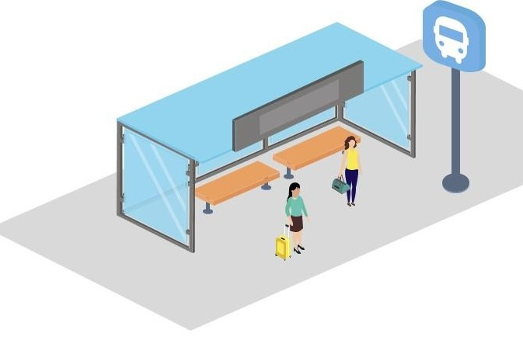
Urban Pulse

Slide 2
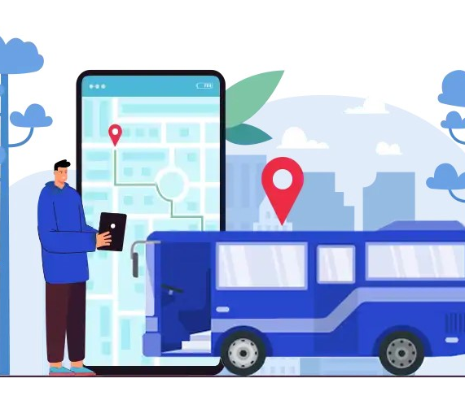
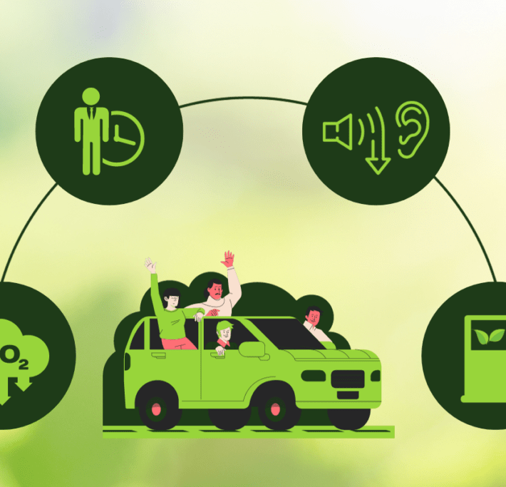
Goal
The goal of the proposed system is to provide commuters an application for real time bus tracking along with alternate carpooling.
The system gives two solutions
Real-time Bus tracking
Carpooling

Slide 3
How it works
Real-Time Bus Tracking:
Open the app, enter the source and destination place check for bus availability.
View estimated arrival times and seat availability.
Choose a bus based on the most convenient arrival time and availability.
Carpooling Integration:
Set the source and destination place.
Find available carpool matches based on route preferences.
Book a ride with another commuter or request a ride.
Feedback:
After the ride, provide feedback on bus services or carpool experience.
Feedback is analyzed to improve services, such as reducing overcrowding or optimizing carpool routes.

Slide 4
Key Features
Real-Time Bus Tracking:
Live updates on bus location and expected arrival time.
Notifications for any delays or changes to routes.
Option to track multiple buses in real time for better planning.
Carpooling:
Find carpool matches based on location and timing preferences.

Slide 5
Benefits of the solution
Increased Efficiency
Commuters can plan their trips with accurate, real-time bus information.
Carpooling reduces the number of private vehicles on the road, alleviating traffic congestion.
Improved Comfort and Convenience
Reduced overcrowding on buses by encouraging carpooling options.
Flexible ride options with carpooling, especially during peak hours.
Cost Savings
Sharing rides through carpooling helps reduce commuting costs for users.
Economical, especially for daily commuters and those in low-income areas.
Environmental Benefits
Reducing the number of vehicles on the road helps lower carbon emissions.
Encourages the use of public transport, leading to cleaner, greener cities.
Enhanced Commuter Satisfaction
The feedback system allows for continuous improvements based on commuter suggestions.
Fosters trust in public transportation with accurate, reliable service.

Slide 6

THANK YOU

